Slide 1

Effect of the COVID-19 pandemic on the risk in the Croatian Capital Market
Marija Ivankovic
Capstone
Prof. Andrija štajduhar

Slide 2
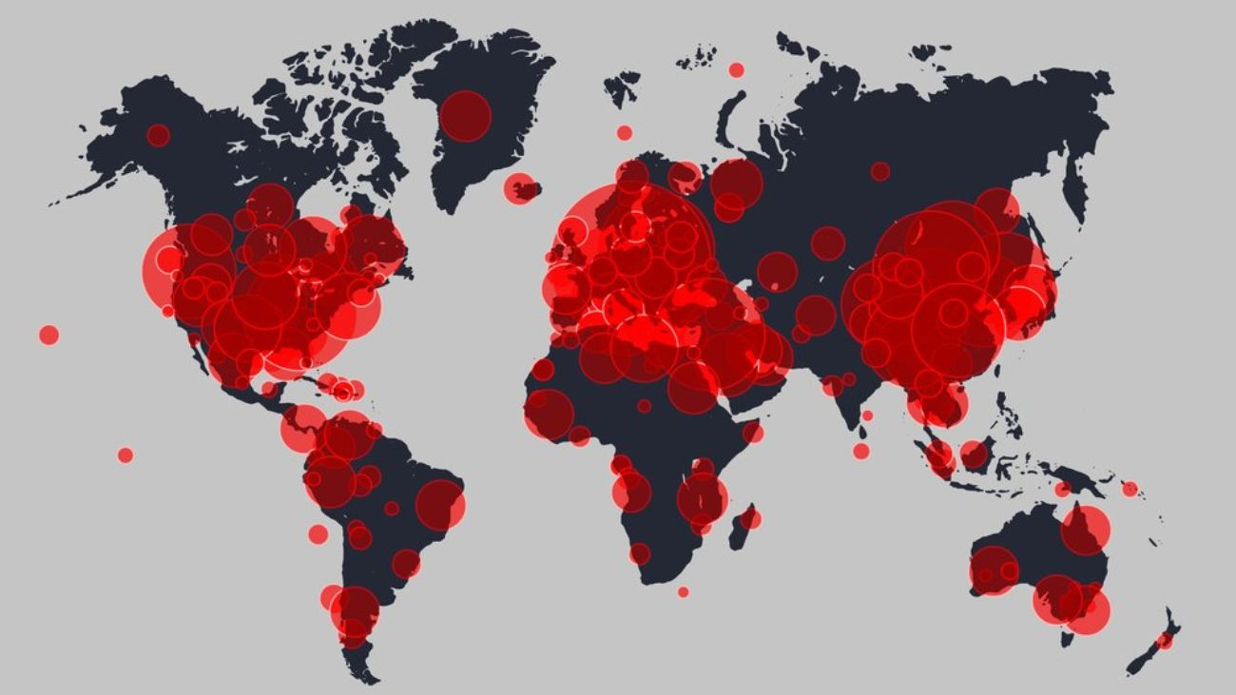
Beggining of the pandemic
Sars-CoV-2
Lockdowns starting in March 2022
Preventative health measures
Mitigating economical measures
Economics crises

Slide 3
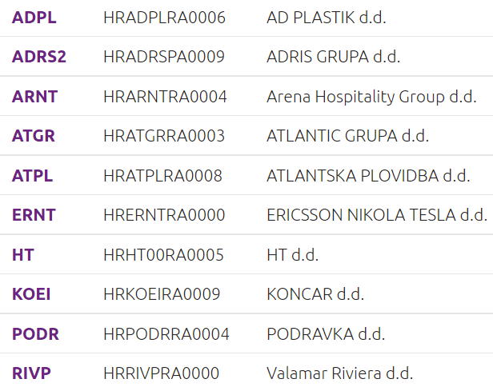
Research problem
Effect of the pandemic on the risk on
Croatian Capital market
Prices of 10 shares from CROBEX10
index as an arbitrary portfolio
Calculate two types of risk
Main hypothesis: risk increased

Slide 4

Risk
Risk vs financial risk
Specific and systematics risk
Returns
$r=\frac{P\left(t+1\right)−Pt+Div}{Pt}$
Risk on an asset depends on the dispersion or spread of possible outcomes
$$σ^{2}=\frac{1}{N−1}Σ {\left(r−E\left(r\right)\right)}^{2}$$
Expected return
$$E\left(r\right)=Σr∗p$$

Slide 5

Systematic risk
Undivesifiable of market risk
Measured against a benchmark or a market portfolio
Beta coefficient-measure of systematic risk
$$β=\frac{cov\left(r,rM\right)}{σ^{2}M}$$
$$β=Σwi∗βi$$

Slide 6
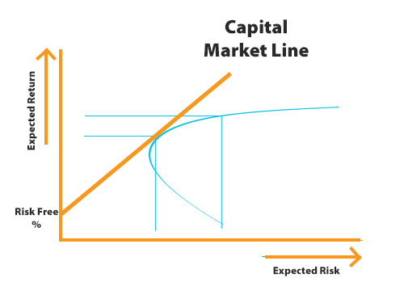

Risk and returns
CAPM model
Direct link between risk and return
minimum acceptable return
$E\left(r\right)=rf+β\left(rm−rf\right)$
Allows us to calculate beta in our research as a
slope using linear regression

Slide 7
Research
Stock price analysis
Missing data
Interpolation method
Calculation of beta
Calculation of VaR
Correlation analysis

Slide 8
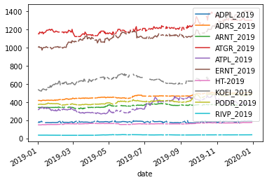
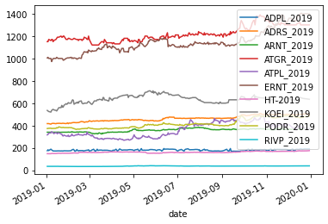
Missing data
Before interpolation
After Interpolation

Slide 9
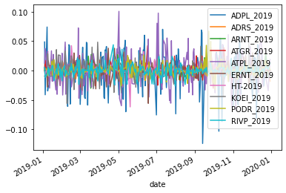
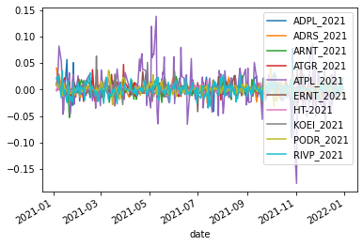
Stock price analysis
Returns of stocks 2019
Returns of stock 2021

Slide 10
Stock price analyisis
Standard deviation of each stock for both time periods
ADPL_2019 | 0.028401
ADRS_2019 | 0.005917
ARNT_2019 | 0.007862
ATGR_2019 | 0.010788
ATPL_2019 | 0.025514
ERNT_2019 | 0.010683
HT-2019 | 0.007119
KOEI_2019 | 0.013376
PODR_2019 | 0.010027
RIVP_2019 | 0.009412
ADPL_2021 | 0.013959
ADRS_2021 | 0.009156
ARNT_2021 | 0.010136
ATGR_2021 | 0.010246
ATPL_2021 | 0.032458
ERNT_2021 | 0.009185
HT-2021 | 0.005712
KOEI_2021 | 0.010603
PODR_2021 | 0.009451
RIVP_2021 | 0.011923

Slide 11

Stock price analysis
Standard deviation of a portfolio
$σ=\sqrt{w^{T}∗Cov∗w}$
$w^{T}$-transposed weights
$Cov$-covariance matrix
$w$-weights
Standard deviation 2019= 0,00002841
Standard deviation 2021=0,00003555

Slide 12
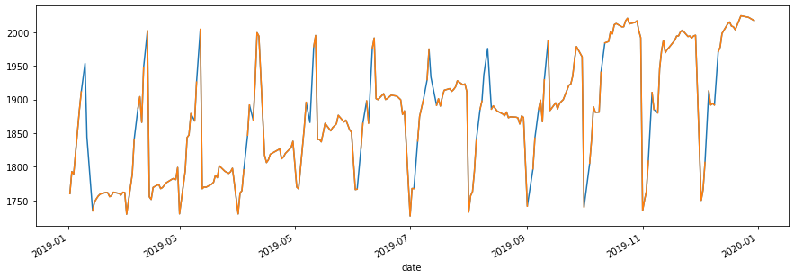
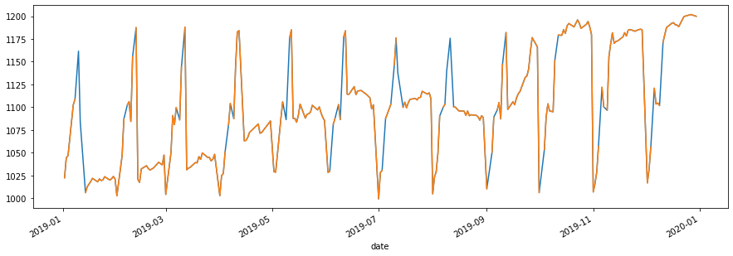
Beta calculation

Slide 13
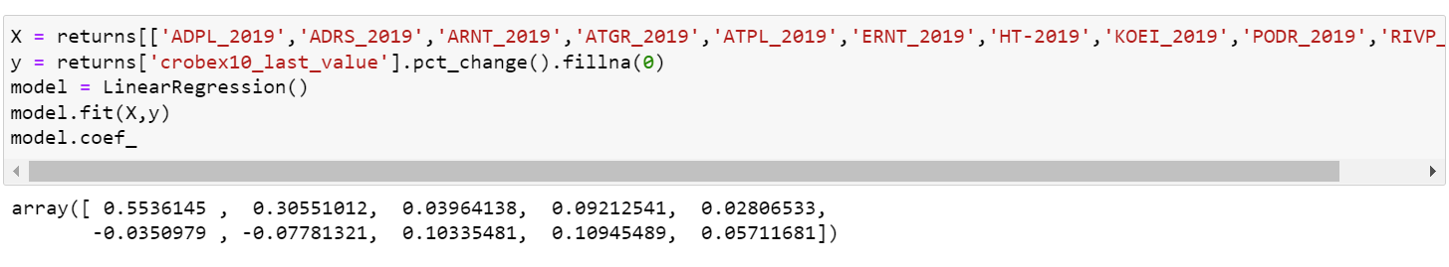
Linearregression()

Slide 14
Beta coefficients-2019
CROBEx
CROBEX10
ADPL | 0,486
ADRS2 | 0,201
ARNT | 0,004
ATGR | 0,110
ATPL | 0,040
ERNT | -0,045
HT | -0,064
KOEI | -0,047
PODR | 0,064
RIVP | 0,030
ADPL | 0,553
ADRS2 | 0,306
ARNT | 0,040
ATGR | 0,092
ATPL | 0,028
ERNT | -0,035
HT | -0,078
KOEI | 0,103
PODR | 0,109
RIVP | 0,057

Slide 15
Beta coefficients-2021
CROBEX
CROBEX10
ADPL | 0,126
ADRS2 | 0,083
ARNT | 0,062
ATGR | -0,240
ATPL | 0,149
ERNT | 0,269
HT | -0,036
KOEI | 0,122
PODR | 0,106
RIVP | -0,034
ADPL | 0,104
ADRS2 | 0,067
ARNT | 0,056
ATGR | -0,123
ATPL | 0,123
ERNT | 0,234
HT | 0,032
KOEI | 0,116
PODR | 0,118
RIVP | -0,053

Slide 16
Comparing betas
CROBEX beta 2019=0,088
CROBEX10 beta 2019=0,118
CROBEX beta 2021=0,061
CROBEX10 beta 2021=0,067

Slide 17
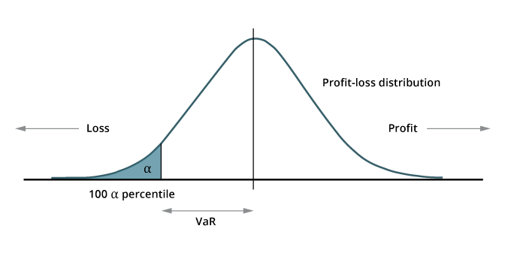

Calculating VaR
VaR-Value at risk
$VaR \left(1−α\right)=Fc^{−1}\left(1−α\right)$
$F{c^{.}}^{−1}$-inverse of the loss distribution function
$1−α$-quantile of the loss distribution function corresponding to the confidence interval
$α$-probability that the actuall loss will be greater
than VaR value
Initial investment=100 000
VaR_2019=804,47
VaR_2021=888,68

Slide 18
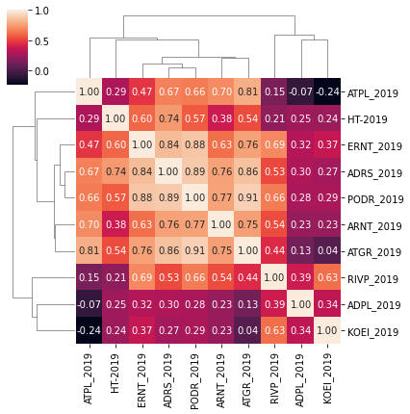
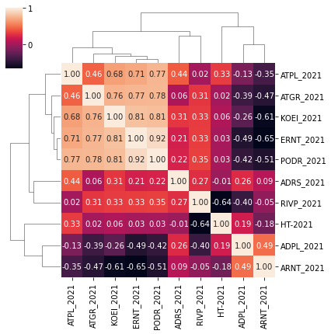
Correlation and diversification

Slide 19
Conclusion
Risk in the capital markets is a vital thing when deciding to invest
Taking the risk depends on the risk preference of the investor
Did risk actually increase?

Slide 20
Thank you for you attention!

